Slide 1
Analysis of campaigns.

Slide 2
Table of Contents
Section 1: Comparing the difference between The Facebook and Adwards platform’s data.
Section 2: Ensure that the data is normally distributed.
Section 3: Testing if Ad conversions will be greater if we advertise on platform Facebook rather than platform AdWords.
Section 4: Predict the Facebook Ad conversions from Facebook Ad clicks.
Final insights.

Slide 3
Section 1

Slide 4
Comparing the data using measures of center
First: The number of clicks data.
Facebook platform:
Mean: 44.04
Median: 43
Mode: 36
Adwards platform:
Mean: 60.38
Median: 60
Mode: 78

Slide 5
Comparing the data using measures of center
Secound: The number of conversions.
Facebook platform:
Mean: 11.7
Median: 12
Mode: 13
Adwards platform:
Mean: 5.9
Median: 6
Mode: 5

Slide 6
Standard Deviation
Determining variance in data to understand the spread of all data points in the data set.
Standard Deviation of Clicks: 14.3
Standard Deviation of Conversions: 1.6

Slide 7
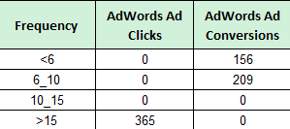
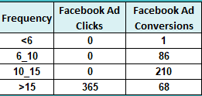
Clicks and conversions Frequency Tables.
Understanding how often something happens is important to understanding trends and patterns in your data

Slide 8
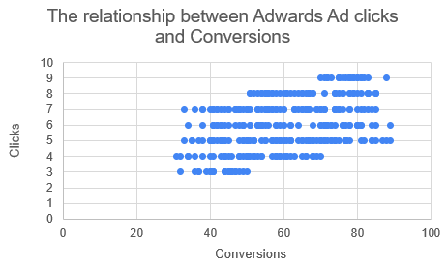
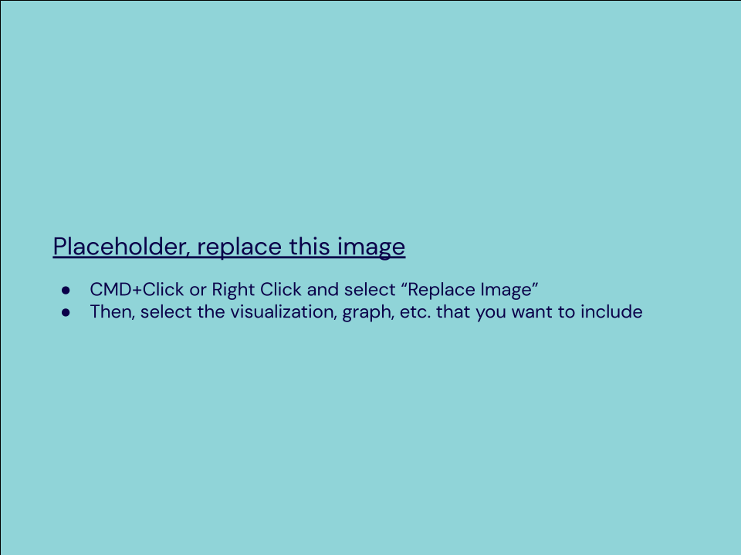
The relationship between Ad clicks and Conversions in Adwards platform.
Scatter Plot of your data:
Correlation coefficient: .447
So it’s a weak relationship

Slide 9
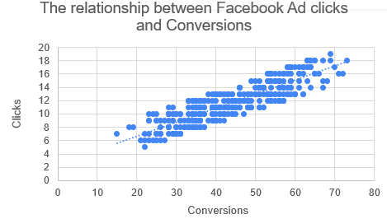
The relationship between Ad clicks and Conversions in Facebook platform.
Correlation coefficient: .87
So it’s a strong relationship

Slide 10
End of Section 1

Slide 11
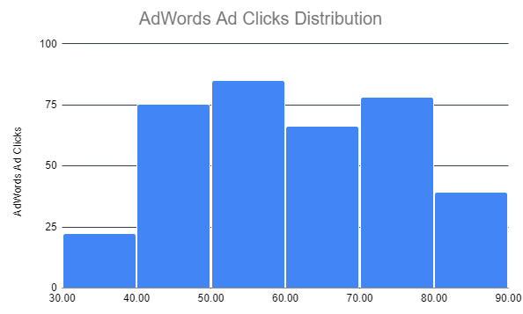
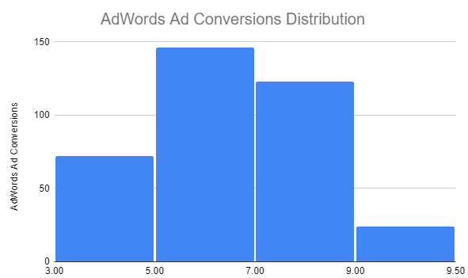
Sample Type
It’s important to understand the sample’s distribution.
Histogram of Ad clicks data:
Histogram of Ad conversions data:

Slide 12
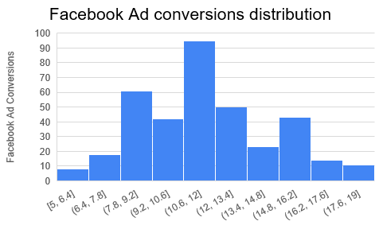
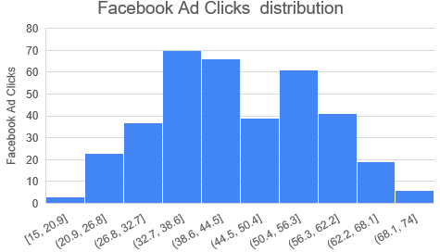
Sample Type
Histogram of Ad clicks data:
Histogram of Ad conversions data:

Slide 13
From the charts:
The Ad clicks data have a normal distribution.
The Ad conversions data have a normal distribution.

Slide 14
End of Section 2

Slide 15
Question and Hypothesis
Our number of conversions will be greater if we advertise on platform Facebook rather than platform AdWords.
H0 there is no significant difference between number of conversions from platform Facebook and platform AdWords.
H1 there is a significant difference between number of conversions from platform Facebook and platform AdWords.

Slide 16
Running a Test
Mean number of Facebook conversions: 11.7
Mean number of Adware conversions: 5.9
p-Value: .00

Slide 17
Hypothesis
The p-value<Alpha;
So we reject the null hypothesis H0 and accept the alternative hypothesis H1 as there is a significant difference between conversions from Facebook and from platform AdWords.

Slide 18
End of Section 3

Slide 19
Determining a Model to predict the Facebook Ad conversions from Facebook Ad clicks.
Simple linear regression is the best model as the independent variable(Facebook Ad clicks) is quantitive, the dependent variable (Facebook Ad conversions) also quantitive, finally the purpose of this model is predicting the dependent variable using the independint variable.
Also we choose linear regreshon For its assumptions:
Linearity: There is a linear relationship between the independent variable(Facebook Ad clicks), and the dependent variable (Facebook Ad conversions) as shown in the 19th slide.
The minimum sample size is 20 in the model: and there is 365 observation in the data
Normality: the data is normal enough as it appears in the previous section.
Homogeneity of the variance: The Facebook Ad clicks variance= 147 and the Facebook Ad conversions variance = 8 which may decrease the prediction accuracy.
Independence: Every observation is independent of every other.

Slide 20
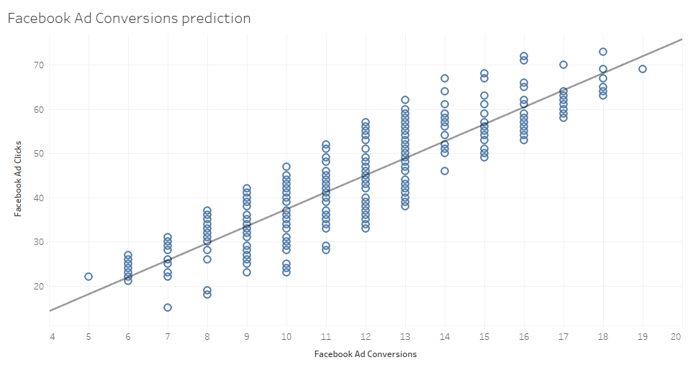
Modeling
A visualization of the model.
From the chart when there is 50 Facebook Ad clicks we expect 13 Facebook Ad conversions.

Slide 21
End of Section 4

Slide 22
Final Insights
There is a huge difference between the Ad clicks on Adward platform and Ad conversions on Adward platform:
Mean: 60.38 for Ad clicks and becomes 5.9 for Ad conversions.
Median: 60 Ad clicks and becomes 6 for Ad conversions.
Mode: 78 Ad clicks and becomes 5 for Ad conversions.
That means there are many people who don’t complete this step and it’s a problem.

Slide 23
Final Insights
On the other hand for the Facebook platform, the Ad clicks are fewer than Adward platform but Ad conversions Facebook platform are much higher than Adward platform:
Mean: 44 for Ad clicks and become 11.7 for Ad conversions.
Median: 43 Ad clicks and becomes 12 for Ad conversions.
Mode: 36 Ad clicks and becomes 13 for Ad conversions.
So it’s recommended to advertise on the Facebook platform.

Slide 24
Final Insights
Also, the variance and standard deviation of Ad click on the Adward platform are much higher Ad conversions on Adward platform which mean Ad conversions are more balanced.
The relationship between Ad clicks and Conversions is weak in Adwards platform and strong in Facebook platform.
There is a significant difference between conversions from Facebook and from the platform AdWords.
Simple linear regression is a good model to predict the Facebook Ad clicks using Facebook Ad conversions as the dependent variable.

